Slide 1
Optical Fiber Communication

Slide 2
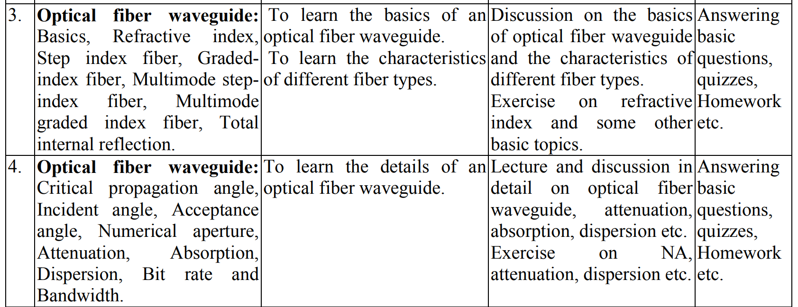

Slide 3
Silica Optical Fibers
Core and cladding made from silica glass which is almost transparent in visible and near-IR. In the case that the refractive index changes in a step between the core and the cladding, this structure is known as step index fiber. Higher core refractive index (0.3% higher) is typically achieved by doping the silica core with germanium dioxide (GeO₂).
A protective coating of one or two layers of cushioning material (such as acrylate) is used to reduce cross talk between adjacent fibers and the loss-increasing micro bending that occurs when fibers are pressed against rough surfaces.
For greater environmental protection, fibers are commonly incorporated into cables. Typical cables have a polyethylene sheath that encases the fiber within a strength membrane such as steel.

Slide 4
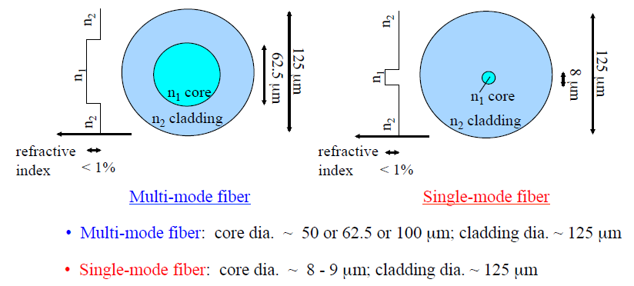
Step-index Silica Optical Fiber Cross-section
Both fiber types can have the same numerical aperture (NA), because NA is independent of the core diameter.

Slide 5
Light Ray Guiding Condition

Slide 6
Light Ray Guiding Condition
through Optical Fiber
Denser medium and light medium
Refractive index
Critical angle
Total internal reflection

Slide 7
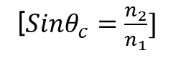
Light Ray Guiding Condition
See the reference Pdf
Snell’s law, critical angle
See the equation
[$Sinθ_{c}=\frac{n_{2}}{n_{1}}]$

Slide 8
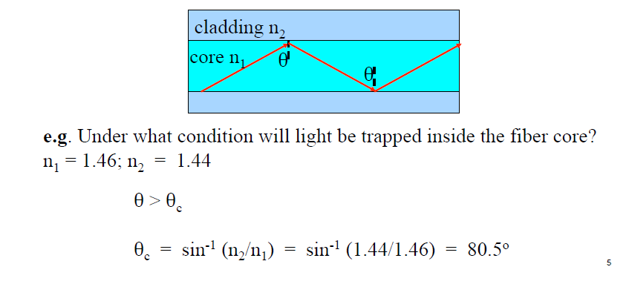
Light Ray Guiding Condition
Light ray that satisfies total internal reflection at the interface of the higher refractive index core and the lower refractive index cladding can be guided along an optical fiber.

Slide 9
Acceptance Angle
Acceptance Cone

Slide 10
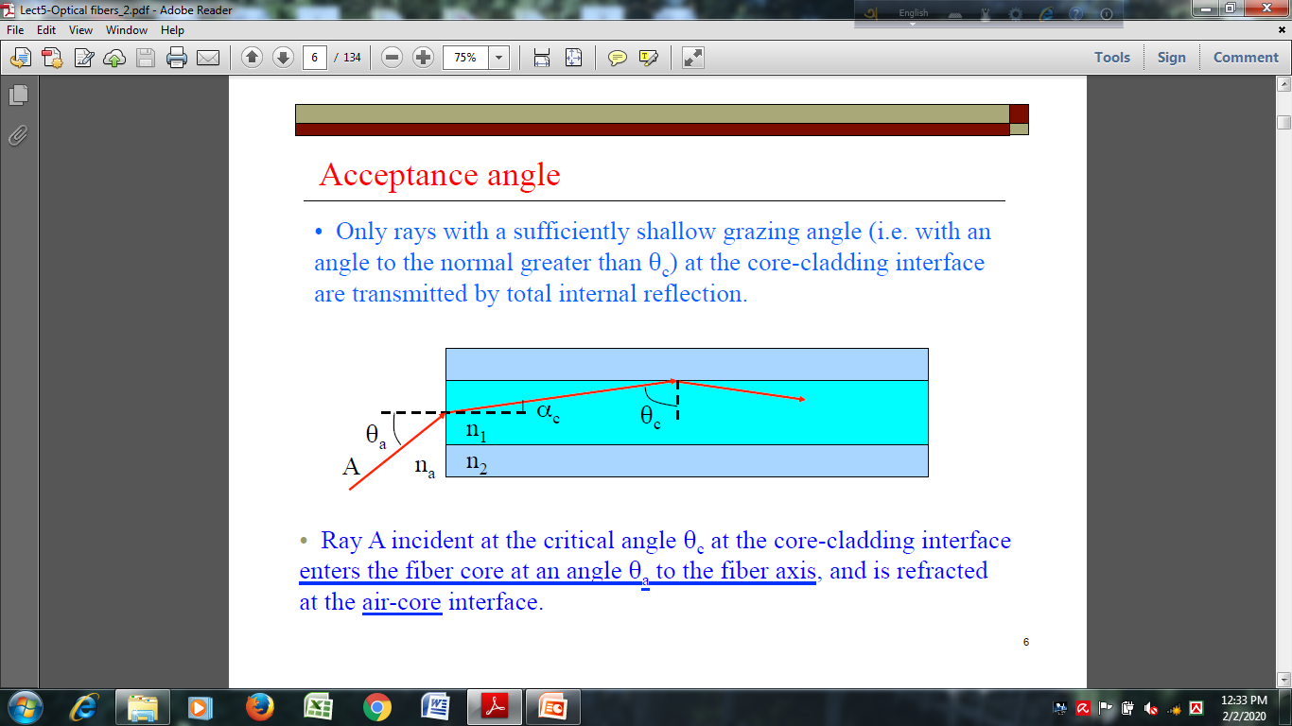
Acceptance Angle
Only rays with a sufficiently shallow grazing angle (with an angle to the normal greater than θ_{c}) at the core-cladding interface are transmitted by total internal reflection. Ray A incident at the critical angle θ_{c} at the core-cladding interface enters the fiber core at an angle θ_{a} to the fiber axis and is refracted at the air-core interface.

Slide 11
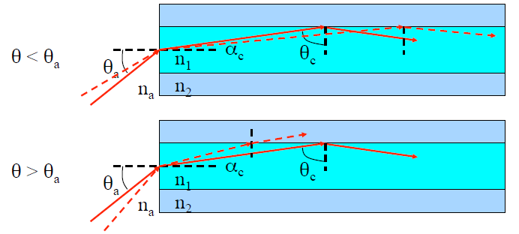
Acceptance Angle

Slide 12
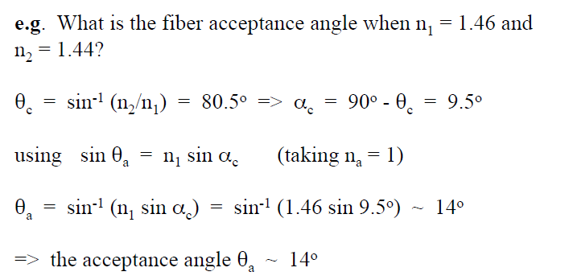
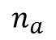
Acceptance Angle
$$n_{a}$$
Light rays will be confined inside the fiber core if it is input-coupled at the fiber core end-face within the acceptance angle θ_{a}.

Slide 13
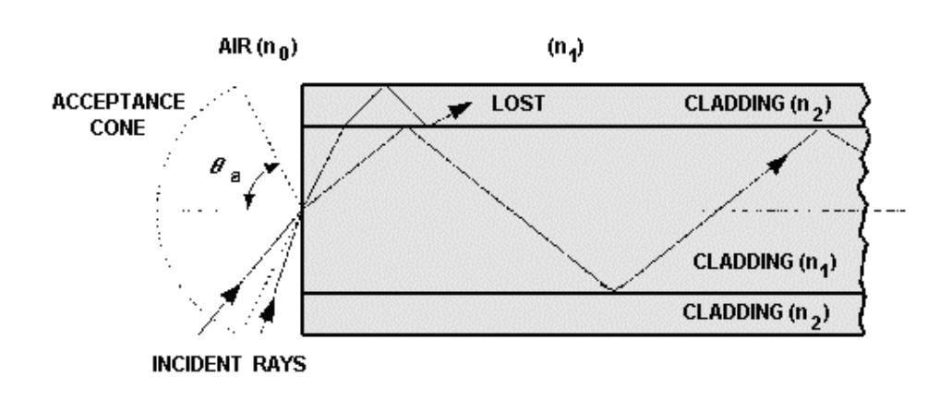

Acceptance Cone
Acceptance cone=$2θ_{a}$

Slide 14
Numerical Aperture (NA)

Slide 15
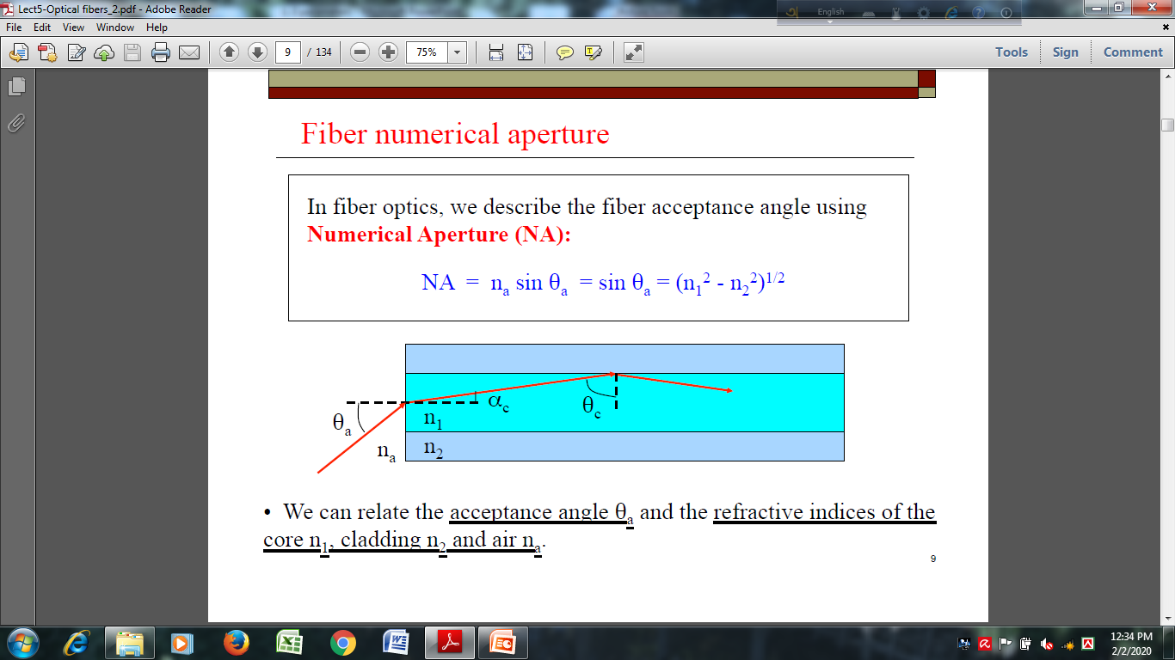
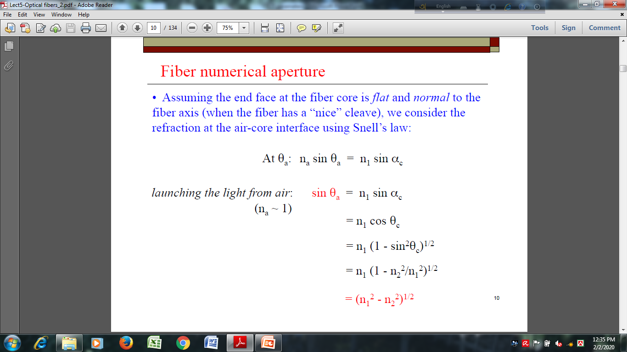
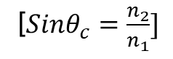
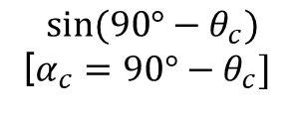
Numerical Aperture (NA)
$$sin⁡(90°−θ_{c})$$
[$α_{c}=90°−θ_{c}]$
[$Sinθ_{c}=\frac{n_{2}}{n_{1}}]$

Slide 16
Numerical Aperture (NA)
The Numerical Aperture (NA) of a fiber is defined as the sine of the largest angle an incident ray can have for total internal reflectance in the core. Rays launched outside the angle specified by a fiber’s NA will excite radiation modes of the fiber. A higher core index, with respect to the cladding, means larger NA.
However, increasing NA causes higher scattering loss from greater concentrations of dopant.
Qualitatively, NA is a measure of the light gathering ability of a fiber. It also indicates how easy it is to couple light into a fiber.
Silica fibers for long haul transmission, NA designed to have the range between 0.1 to 0.3. For short haul communication plastic fibers are used. NA designed to have the range between 0.4 to 0.5.

Slide 17
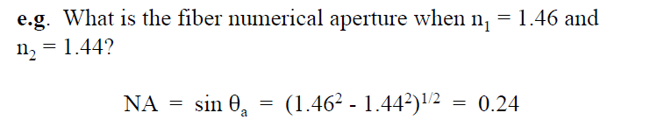
Numerical Aperture (NA) Home Work

Slide 18
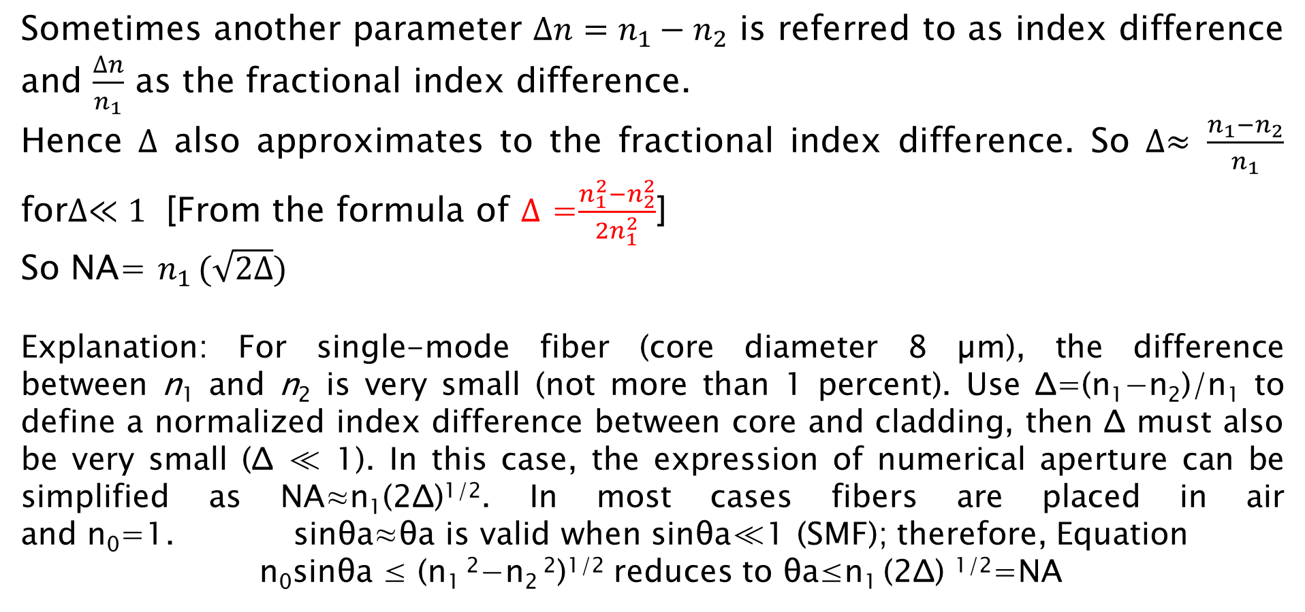

Relative Refractive Index ($∆$)
Sometimes another parameter $∆n=n_{1}−n_{2}$ is referred to as index difference and $\frac{∆n}{n_{1}}$ as the fractional index difference.
Hence $∆$ also approximates to the fractional index difference. So $∆≈ \frac{n_{1}−n_{2}}{n_{1}}$ for$∆≪1$ [From the formula of $∆$ =$\frac{n_{1}^{2}−n_{2}^{2}}{2n_{1}^{2}}$]
So NA= $n_{1 }(\sqrt{2∆})$
Explanation: For single-mode fiber (core diameter 8 µm), the difference between n₁ and n₂ is very small (not more than 1 percent). Use Δ=(n₁−n₂)/n₁ to define a normalized index difference between core and cladding, then Δ must also be very small (Δ ≪ 1). In this case, the expression of numerical aperture can be simplified as NA≈n₁(2Δ)^{1/2}. In most cases fibers are placed in air and n₀=1. sinθa≈θa is valid when sinθa≪1 (SMF); therefore, Equation
n₀sinθa ≤ (n₁ ²−n₂ ²)^{1/2} reduces to θa≤n₁ (2Δ) ^{1/2}=NA

Slide 19
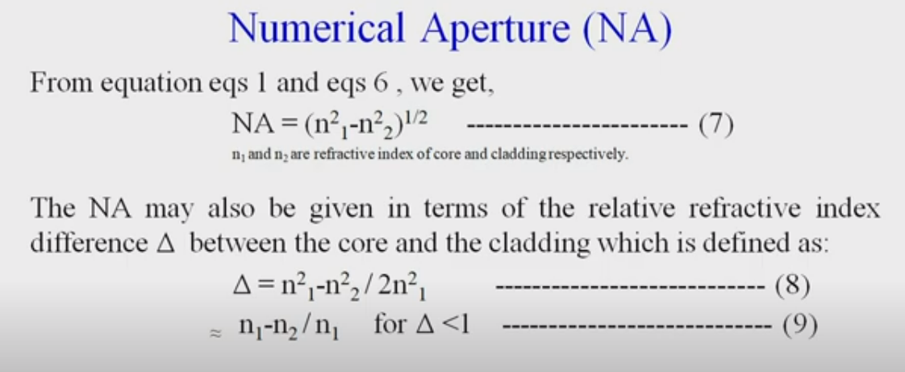

Slide 20
Book ref: OF Communication
John M. Senior
Chapter 2
pp. 14-19

Slide 21
Fiber Classification

Slide 22
Fiber Classification
There are two methods to classify fiber optic cables.
1. Index of refraction variation across the cable cross section. 2. Various paths light rays take to pass through the cable.

Slide 23
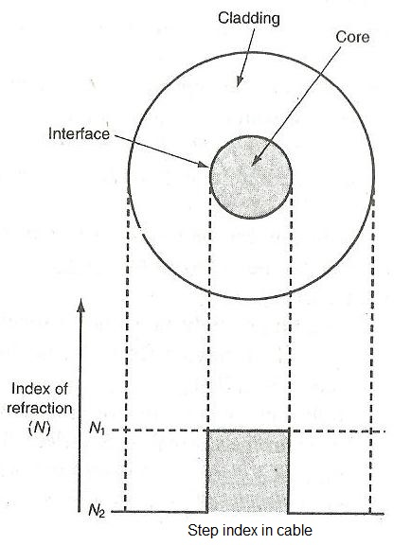
Fiber Classification
In Single mode light takes single path through the fiber core. Step index means sharp step in the index of refraction between core and cladding interface.
This indicates that in step index, core and cladding have their own constant index of refractions N₁ and N₂ respectively.

Slide 24
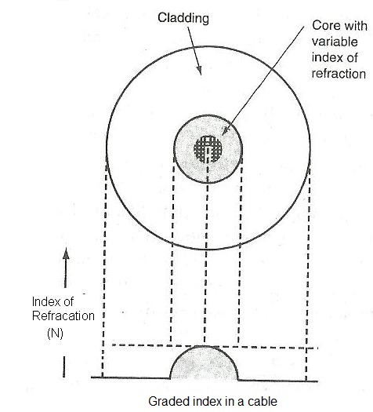
Fiber Classification
In multimode light follows multiple paths through the fiber core.
In graded index, index of refraction is not constant but vary smoothly across the diameter of the core. Index of refraction is increasing as one goes near the center while decreasing near outer core edges. Index of refraction is maximum at the center of the core. Index of refraction is constant for cladding part of the fiber.

Slide 25
Fiber Classification
Based on above, there are three types of fiber optic cable. • multimode step index • single mode step index • multimode graded index
multimode step index fiber cable is widely used due to benefits of large size. It is easier to make and hence less expensive. It is used for shorter distances at very low pulse frequencies.

Slide 26
MM Step Index Fiber
Fiber with large core diameter (greater than 10 micrometers) such fiber is called multi-mode fiber.
In a step-index multi-mode fiber, rays of light are guided along the fiber core by total internal reflection. Rays that meet the core-cladding boundary at a high angle greater than the critical angle for this boundary, are completely reflected.
The critical angle is determined by the difference in index of refraction between the core and cladding materials. The critical angle determines the acceptance angle of the fiber, often reported as a numerical aperture.
In step index fiber rays have different path lengths and therefore take different times to traverse the fiber.

Slide 27
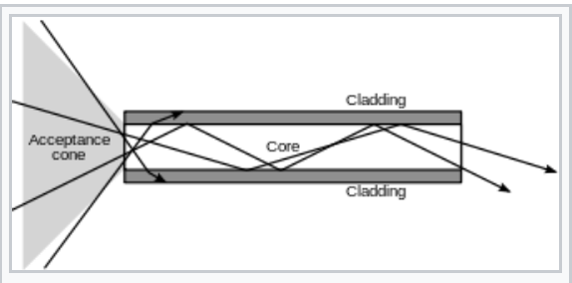
MM Step Index Fiber

Slide 28
MM Graded Index Fiber
In graded-index fiber, the index of refraction in the core decreases continuously between the axis and the cladding. This causes light rays to bend smoothly as they approach the cladding, rather than reflecting abruptly from the core-cladding boundary. The resulting curved paths reduce multi-path dispersion because high angle rays pass more through the lower-index periphery of the core, rather than the high-index center.
This index profile is chosen to minimize the difference in axial propagation speeds of the various rays in the fiber. The ideal index profile is very close to a parabolic relationship between the index and the distance from the axis.

Slide 29
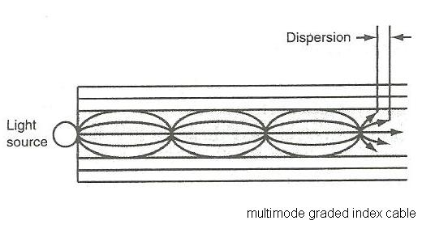
MM Graded Index Fiber

Slide 30
Single mode Step Index Fiber
Fiber supporting only one mode is called single-mode or mono-mode fiber. The most common type of single-mode fiber has a core diameter of 8–10 micrometers and is designed for use in the ”near infrared”.
Multi-mode fiber, by comparison, is manufactured with core diameters as small as 50 micrometers and as large as hundreds of micrometers.

Slide 31
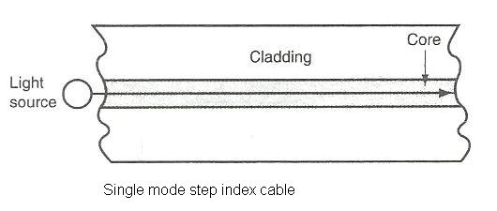
Single Mode Step Index Fiber

Slide 32
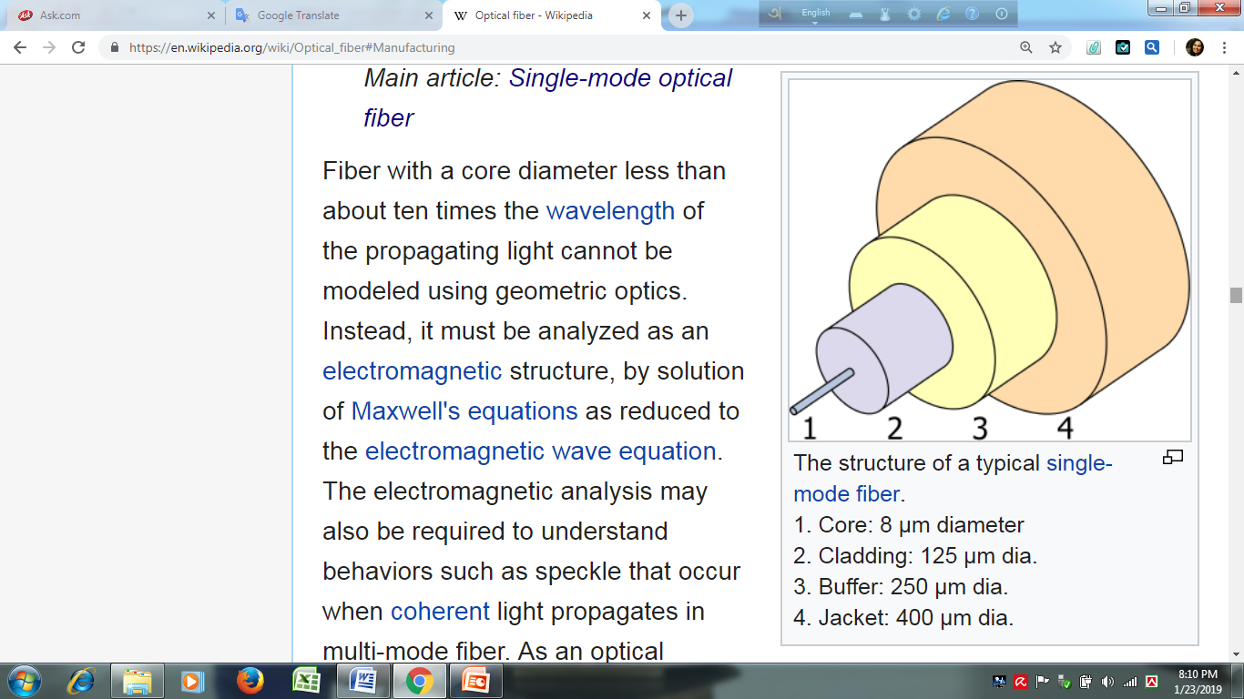

Slide 33
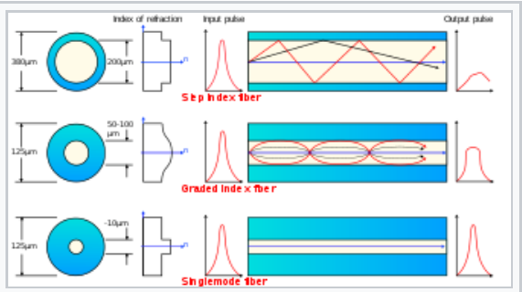
Pulse Shape for Different Fibers

Slide 34
Normalized Frequency/ V Number
Cutoff Wavelength

Slide 35
Normalized Frequency
V Number
There are a few factors that contribute to the type of mode propagation through a fiber. These factors ultimately make up the fiber’s V-number that determines which modes propagate in a fiber. These factors include: indices of refraction of core and cladding, core diameter, and wavelength.
Thus, the factor fiber manufacturers use to control the type of modes a fiber propagates is the core diameter.

Slide 36
Normalized Frequency
V Number
The Normalized Frequency Parameter of a fiber, also called the V number, is a useful specification. Many fiber parameters can be expressed in terms of V, such as: the number of modes at a given wavelength, mode cut off conditions, and propagation constants.
For example, The total number of guided modes M for a step-indexed multimode fiber is approximately related to the V number is given by:
M~ V²/2,
and a step index fiber becomes single-mode for a given wavelength when V<2.405.
Mathematically:
V = 2π.a/λ. NA
= 2πa/λ·(n₁² – n₂²)^{1/2}
= 2πa/λ.n₁ (2∆)^{1/2}
Where, a is the fiber core radius.

Slide 37
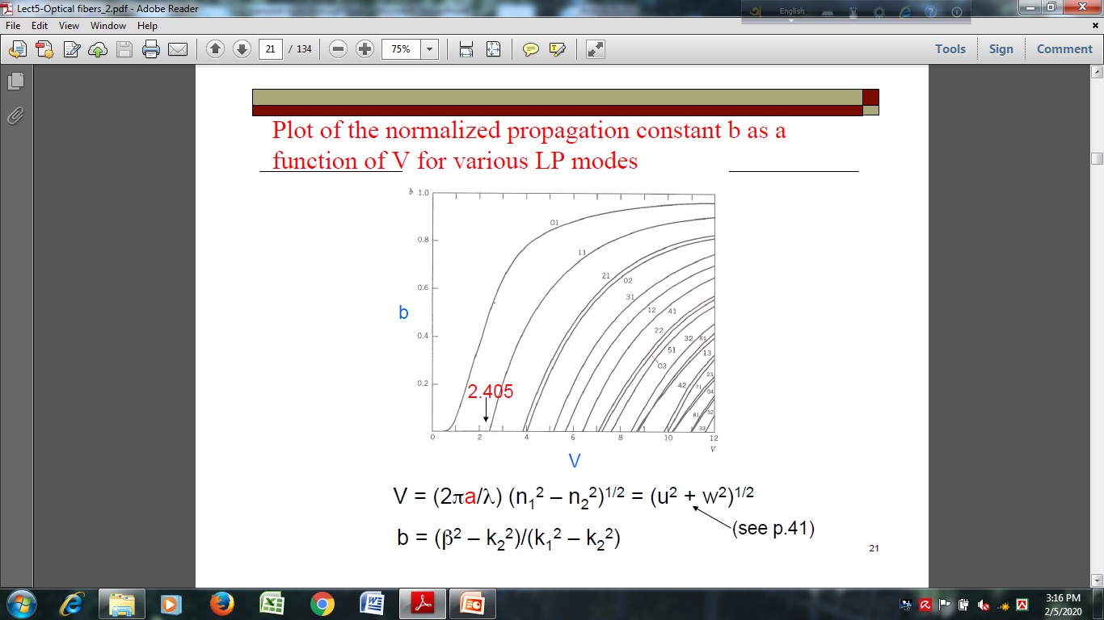
b vs. V graph for Various LP Modes

Slide 38
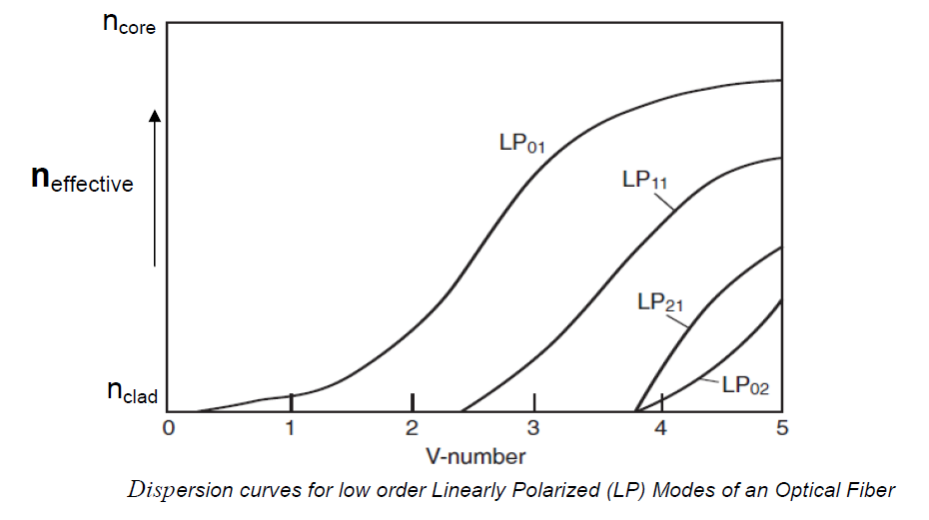
Normalized Frequency
V Number

Slide 39
Single Mode Condition
For single mode operation, only fundamental LP₀₁ mode exists. The cutoff normalized frequency (V_{c}) for the next higher order (LP₁₁) mode in step index fibers occurs at V_{c}=2.405.
Single mode propagation of the LP₀₁ mode in step index fibers: V<2.405 or V<V_{c .}

Slide 40
Normalized Frequency/
V Number Declares Single Mode & Multi Mode Fiber
Single mode (SM) fibers have much smaller core diameters than Multi-Mode (MM) fibers. SM fiber is actually designed to propagate only a single (fundamental) mode from a light source. MM fiber allows higher order modes to propagate from a light source. Each SM fiber has a cut-off wavelength associated with it. The cut-off wavelength is the benchmark where every lower wavelength will propagate high order modes and thus be considered multi-mode at those wavelengths. SM fiber is used to propagate LP₀₁. MM fiber is typically used when beam shape and quality is not a desirable factor. MM fibers in turn have large NAs while SM mode fibers have smaller NAs.

Slide 41
Cutoff Wavelength
Cutoff Wavelength:
λ_{c} = 2πa/V_{c .}(n₁² – n₂²)^{1/2} = 2πa/V_{c}.n₁ (2∆)^{1/2}
a is the fiber core radius
λ_{c} is the cutoff wavelength
V_{c} is the cutoff V number, equals 2.405.
The cutoff wavelength is the minimum wavelength in which a particular fiber still acts as a single mode fiber. Above the cutoff wavelength, the fiber will only allow the LP₀₁ mode to propagate through the fiber (fiber is a single mode fiber at this wavelength). Below the cutoff wavelength, higher order modes, i.e. LP₁₁, LP₂₁, LP₀₂, etc will be able to propagate (fiber becomes a multimode fiber at this wavelength).

Slide 42
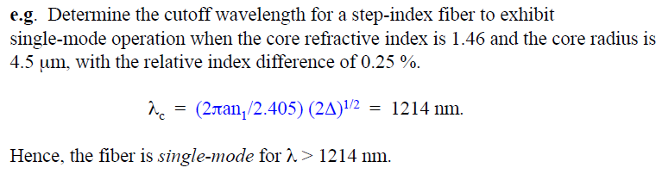
Homework
Example

